Slide 1
NFL Game Predictions
Machine Learning modeling and predictions
By Ramon Tomzer
8/23/23

Slide 2
Outline
Executive Summary
Introduction
Data Collection Methodology
Results
Data Wrangling and Preprocessing
EDA
Model Building
Conclusion
Appendix

Slide 3
Executive Summary
Objective: The project aimed to predict NFL game outcomes by leveraging accumulated season stats, combining a passion for both sports and data science. A model was built to forecast wins and losses, bypassing subjective methods like power rankings.
Data Collection: Data was scraped from a website, focusing on concrete evidence like cumulative stats across Offense, Defense, and Special Teams. The data sets were merged on "Team" and "Week" features.
Data Preprocessing: Preprocessing involved understanding the data, evaluating its shape, content, and null values. Techniques were applied to impute and fill missing values.
EDA (Exploratory Data Analysis): Redundant and uncorrelated features were removed, with Principal Component Analysis (PCA) and feature standardization applied.
Model Building: PyCaret was utilized for model building due to its simplicity and integration with many models. Logistic Regression emerged as the top candidate, with Ridge Classifier, Linear Discriminant Analysis, and Light Gradient Boosting Machine following closely. The final model chosen was a Stacked tuned model, considering various metrics.
Model Performance:
Accuracy (92.73%): Indicates highly reliable forecasts.
AUC (96.43%): Signifies excellent separation between win and loss.
Recall (96.43%): Ensures capturing all winning instances.
Precision (90.00%): Important for minimizing false win predictions.
F1 Score (93.10%): Reflects a well-rounded performance, balancing precision and recall.
Kappa (85.43%): Underscores consistent predictions.
MCC (85.66%): Demonstrates effectiveness across all aspects of binary classification.
Conclusion: The model demonstrates a robust ability to predict NFL game outcomes, with high accuracy, precision, recall, and other substantial metrics. It could be vital for stakeholders in sports analytics, betting, and strategic planning. Continuous validation on new data is recommended to sustain or enhance performance.

Slide 4
Introduction:
The objective of this project was to bring together two things I have a passion for... Sports and Data Science!
The main goal of the project was to help predict the outcome of games based on accumulated stats through out the season.
As we all know, the most important part of data science is… well… the data. So lets start there.

Slide 5
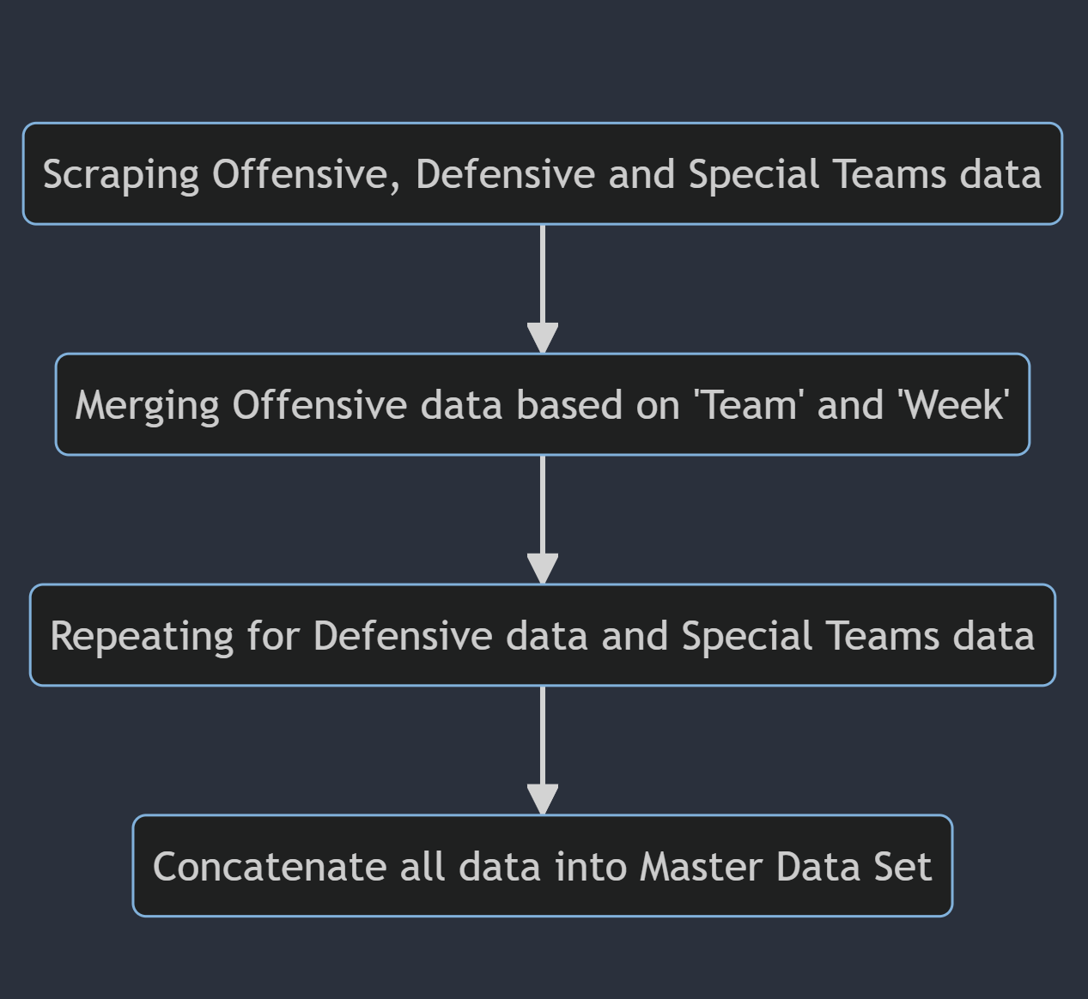
Data Collection:
There is a plethora of data to be found in sports, especially in football. I originally had the idea to attempt to make predictions based on power rankings, and as I delved deeper into what that power rankings actually are, I learned that they are very subjective.
This pushed me to want to make predictions based on concrete evidence, something like cumulative stats for instance.
I scraped data from this website in order to build out my data set. Once I had the major stats for Offense, Defense and Special Teams, I joined the Offensive data sets by merging on “Team” and “Week” features. I also did this with Defensive and Special Teams data sets.

Slide 6
Data Preprocessing:
The next step of the process was Data Preprocessing. This involved techniques such as :
Getting familiar with the data
Evaluating the data shape
Evaluating data content and looking for missing or null values
Imputing and filling null values

Slide 7
EDA (Exploratory Data Analysis):
At this point I had an over abundance of information, so I ran some correlation tests in order to see which features were highly correlated. This allowed me to drop redundant features and weed out some noise in the data.
I then performed Principal Component Analysis in order to further reduce dimensionality of the data. I ran comparisons on whether I should reduce dimensionality based on a percentage of variance or a constant number of components. In the end I settled on keeping a constant number of 20 components, as I knew my end goal was to run unseen data through the final model to see playoff “predictions”.

Slide 8
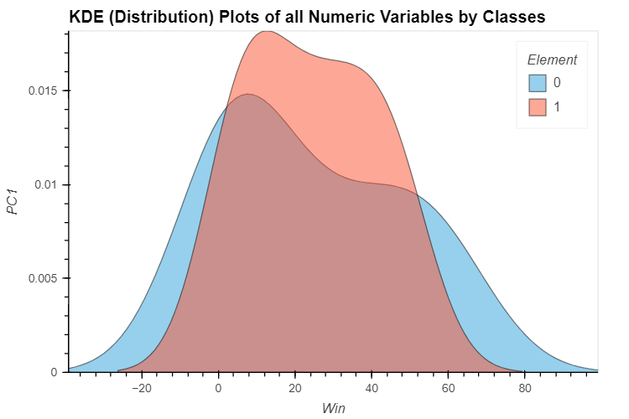
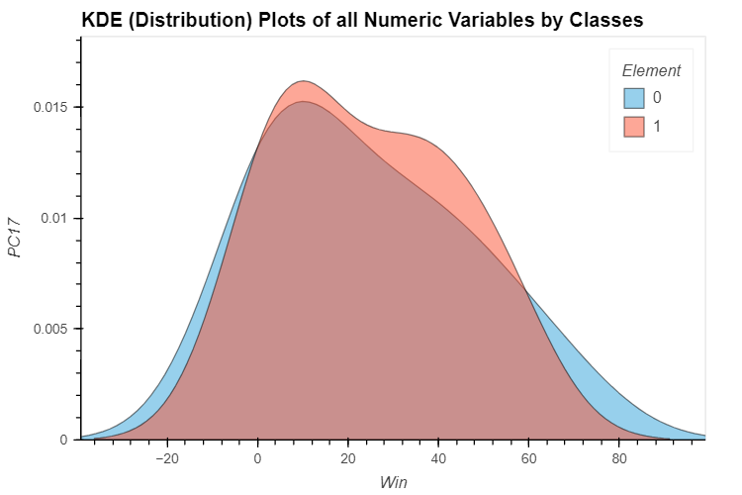
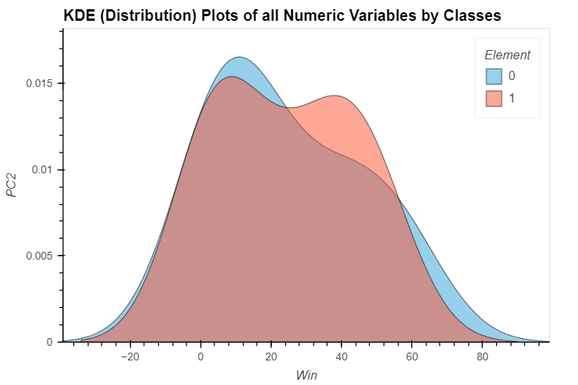
EDA Continued:
Next, I plotted the KDE for multiple features against our target feature (Win) to better understand the distribution of data and its relation to the target feature. In these cases, we see differences among the distribution of these components vs “Win”

Slide 9
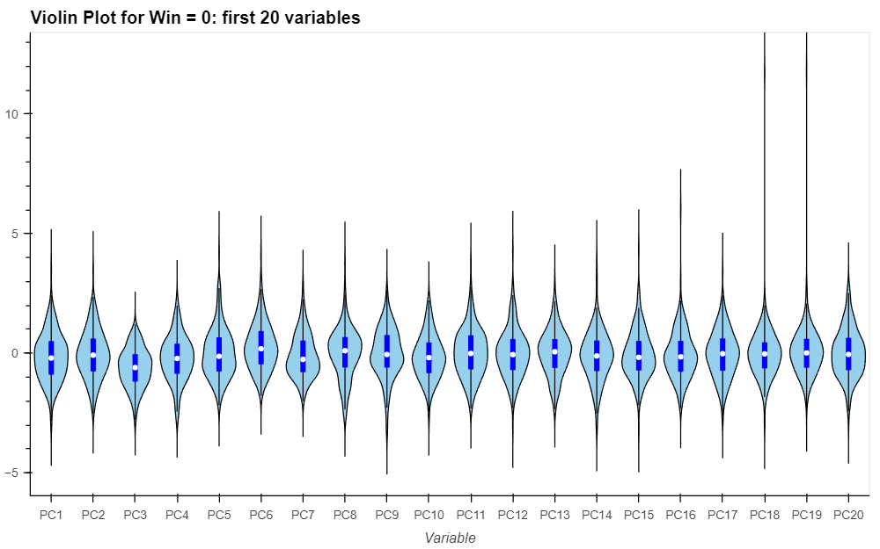
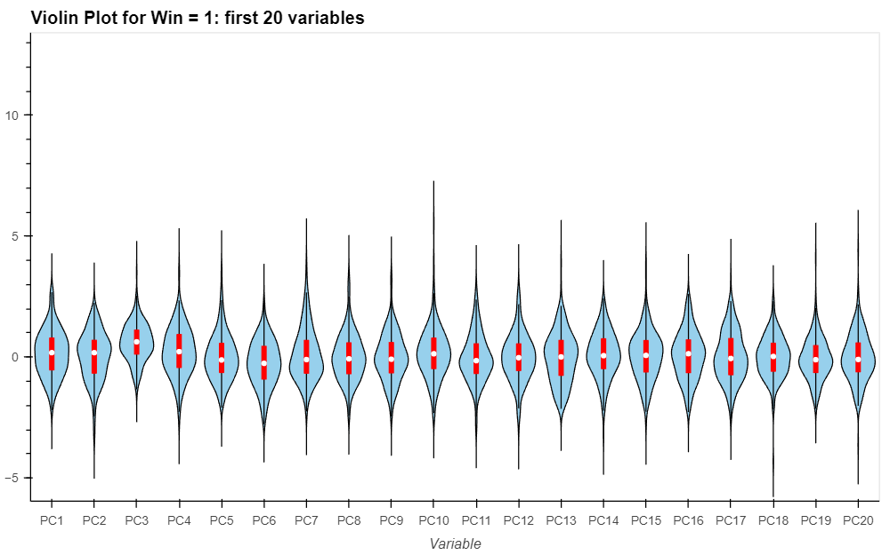
EDA Continued:
I also charted violin plots to help understand the distribution of “Win” amongst the components. This showed varying degrees of distribution. See below.

Slide 10
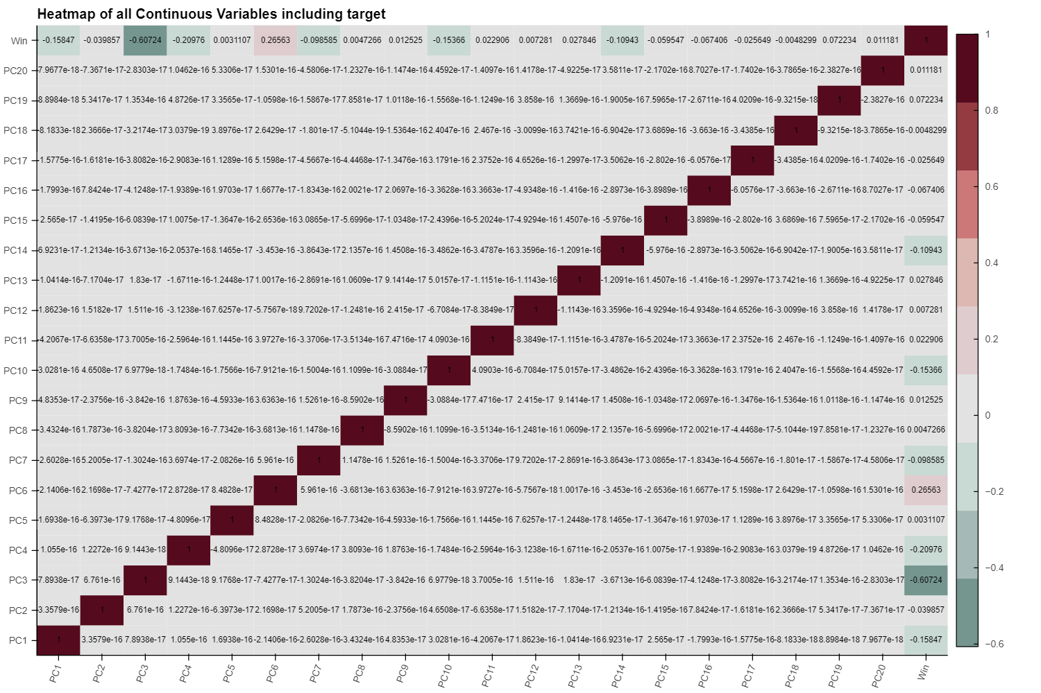
EDA Continued:
This heatmap shows the correlation between the other features and the target feature. One thing that jumps out is that some of the features are inversely correlated.
PC3 seems to have a fairly high inverse correlation, while other did not have much correlation at all.
This worried me at first because I did want to drop so much data that the prediction model would only be working with a small number of factors.
Because of that I decided to continue with those features and see how the prediction power of the model came out.

Slide 11
Model Building:
Once I had examined the data I was working with, it was on to model building.
To do this I decided to use PyCaret, due to its simplicity, integration with many models and overall ease of use.
I first needed to determine which model or models I would use, so I ran a model comparison on the training data.
I split our whole data into 2 parts. 10% would be set aside as a validation, and the rest would be used in experiment setup. It should be noted that PyCaret makes a holdout set when you use the setup experiment method. In this case, I chose to take 15% of the data as a holdout set.

Slide 12
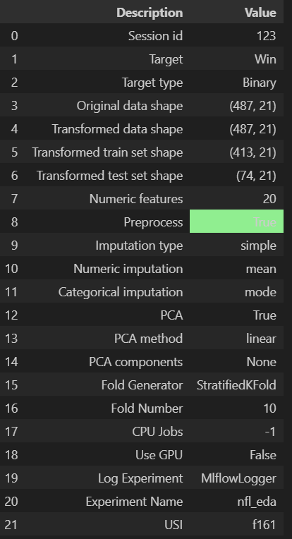
Model Building: Continued
The experiment was setup with these parameters
The models would be trained on a 10 fold stratified k fold method
20 Principal Components
Training Data Shape of 487, 21 (target variable included)
Test Data Shape of 74, 21 (target variable included)
Experiment type – Binary Classification
I thought about including tie games, but when researching the data, since overtime was introduced in 1974, there have only been 29 tie games. With an approximate 27,000 total games played since 1974, this left a miniscule 0.00106% chance of a game ending in a tie.

Slide 13
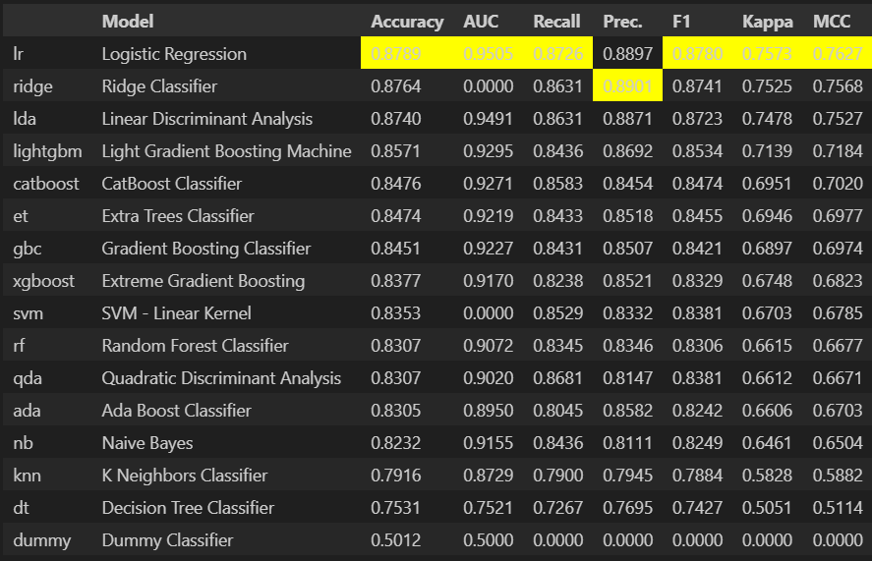
Model Building: Continued
The initial model comparison yielded very promising results.
Logistic Regression was the top candidate, leading in almost all major metrics
Ridge Classifier, Linear Discriminant Analysis and Light Gradient Boosting Machine followed closely behind.
I decided to create those individual models and tune them to see how much performance could be extracted out of each one

Slide 14
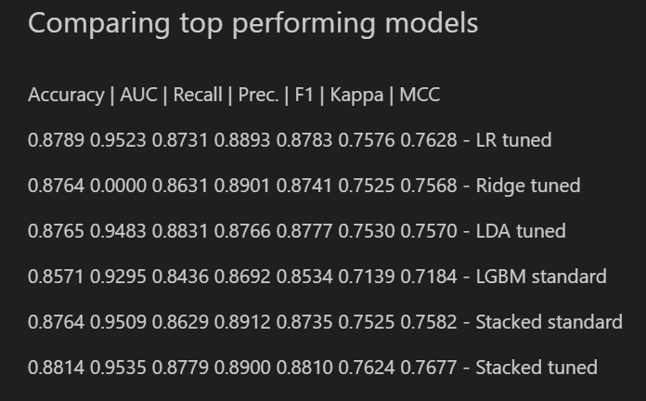
Model Building: Continued
I also decided to create an ensemble model out of the top performing models to see if there was an advantage of using a stacking classifier
The Stacked tuned model barely had an advantage, so I decided on that as the final model. It did not take long to create, nor did it seem much more computationally intensive.

Slide 15
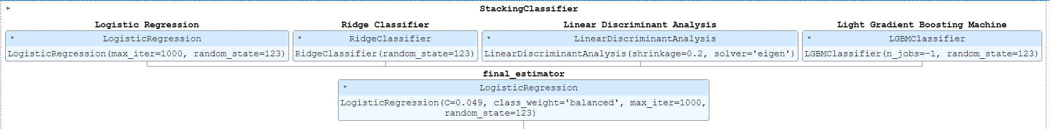
Model Building: Continued
Stacking Classifier Diagram

Slide 16
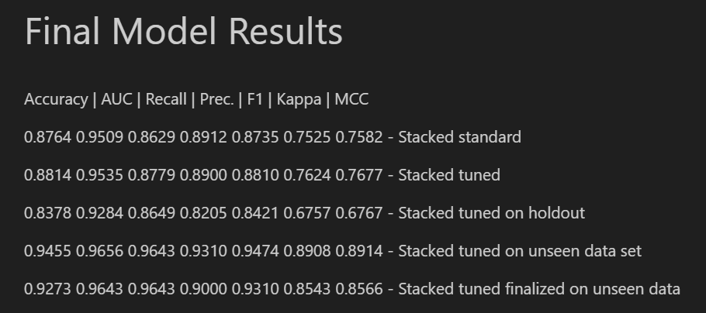
Model Evaluation
The results of the final model show that the model had a statistically significant degree of accuracy, with good recall, precision and F1 scores.
It consistently had a high AUC score as well indicated good performance of the model.

Slide 17
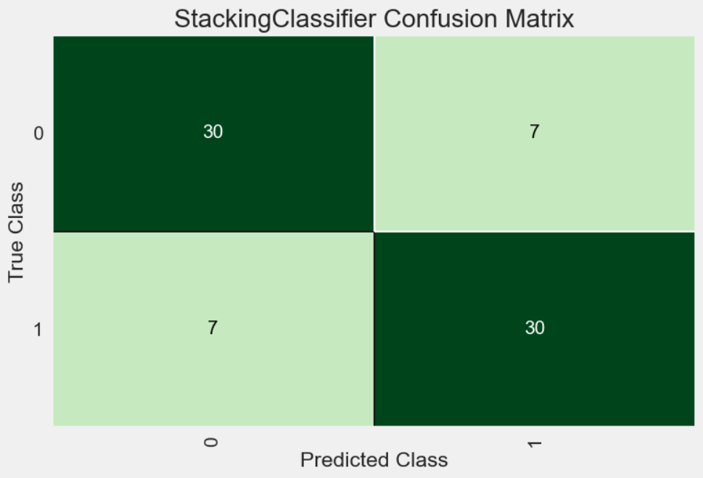
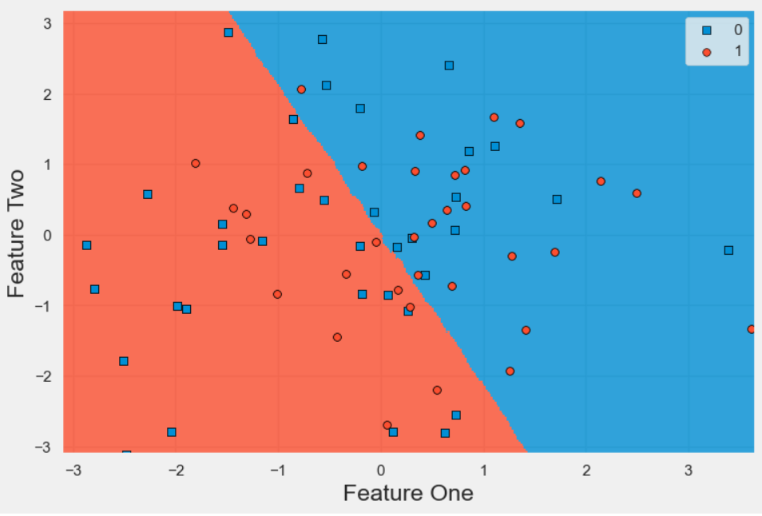
Model Evaluation Continued:

Slide 18
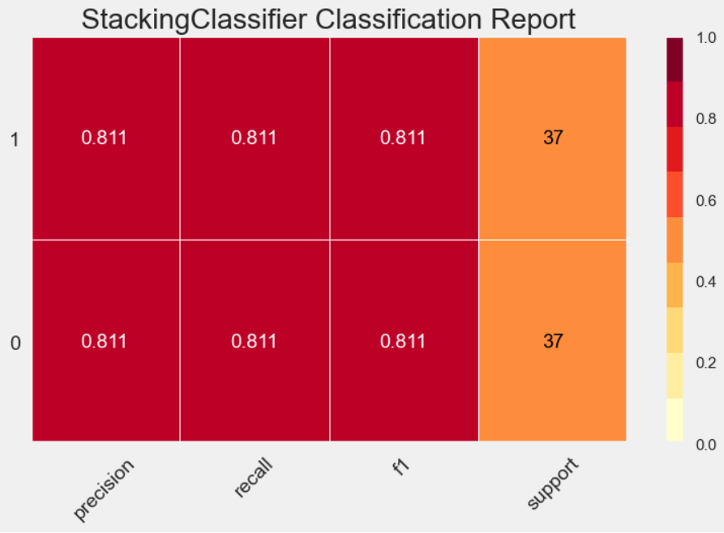
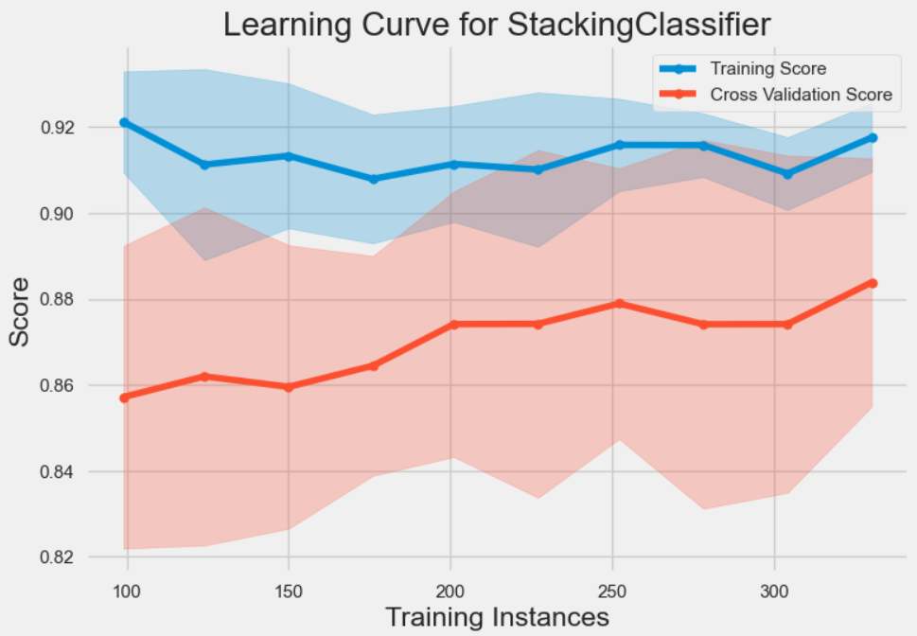
Model Evaluation Continued:

Slide 19
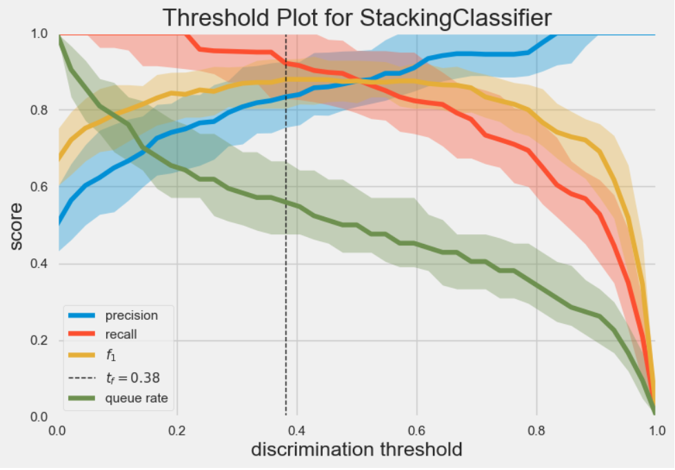
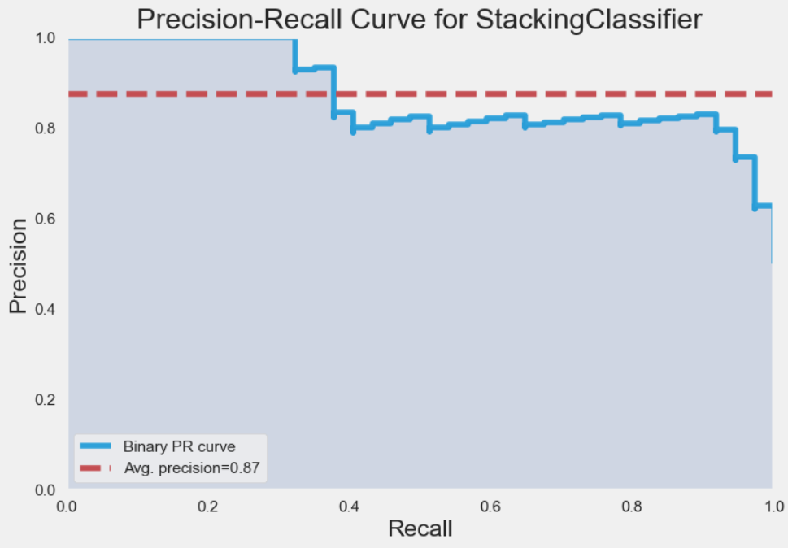
Model Evaluation Continued:

Slide 20
Conclusion:
Accuracy (92.73%): This score indicates that the model correctly predicts the outcome (win/loss) of an NFL game approximately 92.73% of the time. In the context of game predictions, this high accuracy means that the model can be considered highly reliable for forecasting game results.
AUC (96.43%): The Area Under the Receiver Operating Characteristic Curve measures the model's ability to distinguish between winning and losing outcomes. A score of 96.43% signifies excellent separation, implying that the model has a strong understanding of the factors that contribute to a win or loss.
Recall (96.43%): Recall measures the model's ability to correctly identify all actual winning games. A high recall like 96.43% suggests that the model rarely misses a true winning game, making it valuable for applications where capturing all winning instances is crucial.
Precision (90.00%): Precision assesses the model's ability to accurately predict a win without falsely identifying a loss as a win. A precision of 90% means that among the games predicted as wins, 90% were actual wins. This is particularly important in scenarios where false positives (incorrectly predicting a win) can have significant consequences, such as in betting or strategic planning.

Slide 21
Conclusion Continued:
F1 Score (93.10%): The F1 score is a harmonic mean of precision and recall, providing a single metric that balances both aspects. An F1 score of 93.10% shows that the model maintains an excellent balance between identifying all wins (recall) and minimizing false wins (precision), ensuring a well-rounded performance.
Kappa (85.43%): The Kappa statistic measures the agreement between predicted and actual outcomes, considering the agreement that might happen by chance. A Kappa score of 85.43% in predicting NFL games underscores the model's ability to make predictions that are consistently in line with actual game outcomes.
MCC (85.66%): The Matthews Correlation Coefficient is a balanced measure that takes into account all four values of the confusion matrix (TP, FP, TN, FN). An MCC of 85.66% shows that the model performs well across all aspects of binary classification, ensuring its effectiveness even when the class distribution is unbalanced.
In conclusion, the combination of these metrics suggests a comprehensive picture of an effective model for predicting NFL game outcomes. It captures wins accurately, it does a good job at minimizing false predictions, balances precision and recall, reflecting in a good F1 score. Such a model could be of immense value to stakeholders in sports analytics, betting, and strategic game planning. However, continuous validation on new and diverse data is advisable to maintain and potentially improve this performance.

Slide 22
Appendix
Creator's LinkedIn
Creator's Github Dashboard
Project Repository
Data Cleaning Script
Correction of NFL Team Name code
Data Files
Website data was scraped from
More evaluation images

